Slide 1
Topics to be Covered
Source Code (Plain Code)
Source Code Management Tools/Version Control Systems (i.e., Git)
Build Tools (i.e., Makefile)
Continuous Build Integration (i.e., Jenkins)
Shell Scripting
Practice on Android Build System

Slide 2
Version control systems

Slide 3
version control systems
Version control systems are a category of software tools that help a software team manage changes to source code over time. Version control software keeps track of every modification to the code in a special kind of database. If a mistake is made, developers can turn back the clock and compare earlier versions of the code to help fix the mistake while minimizing disruption to all team members.
Developing software without using version control is risky, like not having backups. Version control can also enable developers to move faster and it allows software teams to preserve efficiency and agility as the team scales to include more developers.
CS are sometimes known as SCM (Source Code Management) tools or RCS (Revision Control System).
Types of Version Control Systems:
Local Version Control Systems
Centralized Version Control Systems
Distributed Version Control Systems

Slide 4

Local Version Control Systems
This version control system manages multiple revisions of the files on local system. And if an engineer want to share with peer engineers then complete copy along with the history of the file will be shared.
Example: Revision Control System (RCS)

Slide 5
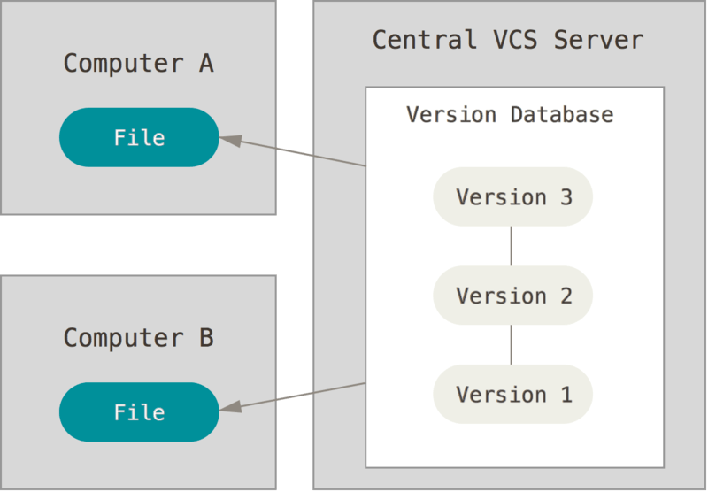
Centralized Version Control Systems
Centralized Version Control Systems (CVCSs) were developed to collaborate with developers on other systems. These systems (such as CVS, Subversion, and Perforce) have a single server that contains all the versioned files, and a number of clients that check out files from that central place.
In this system, if server goes down then nobody knows the history of any of the files except local copy in the computer.

Slide 6
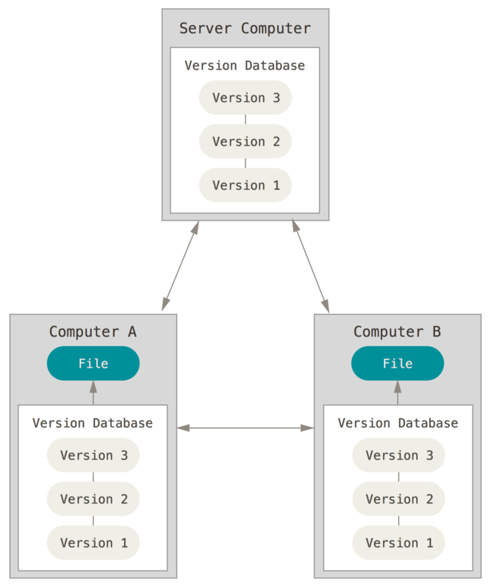
Distributed Version Control Systems
In a DVCS (such as Git, Mercurial, Bazaar or Darcs), clients don’t just check out the latest snapshot of the files; rather, they fully mirror the repository, including its full history. Thus, if any server dies, and these systems were collaborating via that server, any of the client repositories can be copied back up to the server to restore it. Every clone is really a full backup of all the data.

Slide 7
Introduction to Git

Slide 8
Git hub
GitHub is a code hosting platform for collaboration and version control.
GitHub lets you (and others) work together on projects.
Creating the GitHub account
Go to https://github.com/join in a web browser
Signup by providing required details
Click the ”Choose” button for your desired plan(Free). Once you select a plan, GitHub will send an email confirmation message to the mail address you entered.
Verify the mail address
Review your plan selection and click ”Continue”.
Select your preferences and click ”Submit”.
https://help.github.com/en/github/getting-started-with-github/signing-up-for-a-new-github-account
https://www.wikihow.com/Create-an-Account-on-GitHub

Slide 9
Creating git repository in the github
Follow below link:
https://help.github.com/en/github/getting-started-with-github/create-a-repo

Slide 10
GIT
What is Git?
Snapshots, Not Differences
Nearly Every Operation Is Local
Git Has Integrity
Git Generally Only Adds Data
The Three States
Git has three main states that your files can reside in: modified, staged, and committed:
Modified means that you have changed the file but have not committed it to your database yet.
Staged means that you have marked a modified file in its current version to go into your next commit snapshot.
Committed means that the data is safely stored in your local database.

Slide 11
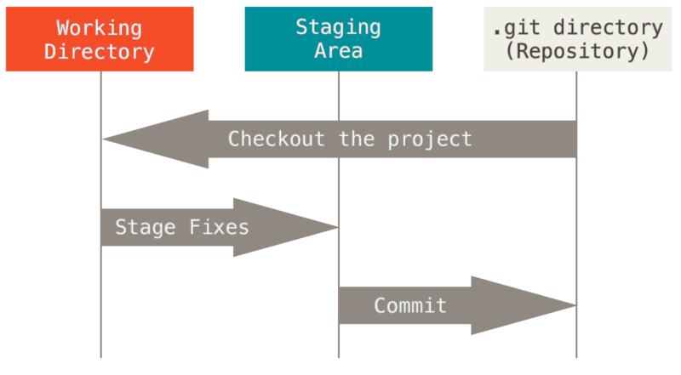
main sections of a Git project
The working tree is a single checkout of one version of the project.
These files are pulled out of the compressed database in the Git directory and placed on disk for you to use or modify.
The staging area is a file, generally contained in your Git directory, that stores information about what will go into your next commit. Its technical name in Git parlance is the “index”, but the phrase “staging area” works
just as well.
The Git directory is where Git stores the metadata and object database
for your project. This is the most important part of Git, and it is what is copied when you clone a repository from another computer.
The basic Git workflow goes something like this:
You modify files in your working tree.
You selectively stage just those changes you want to be part of your next commit, which adds only those changes to the staging area.
You do a commit, which takes the files as they are in the staging area and stores that snapshot permanently to your Git directory.
Git installation on Ubuntu: sudo apt install git-all

Slide 12
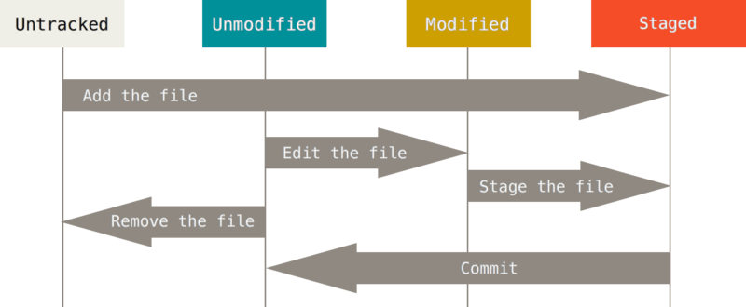
Submitting changes to the repositories
Working directory can be in one of two states:
tracked
untracked
Tracked files are files that were in the last snapshot; they can be unmodified, modified, or staged. In short, tracked files are files that Git knows about.
Untracked files are everything else — any files in your working directory that were not in your last snapshot and are not in your staging area. When you first clone a repository, all of your files will be tracked and unmodified because Git just checked them out and you haven’t edited anything.
As you edit files, Git sees them as modified, because you’ve changed them since your last commit. As you work, you selectively stage these modified files and then commit all those staged changes, and the cycle repeats.
Reference: https://git-scm.com/book/en/v1/Getting-Started-Git-Basics

Slide 13
GIT Commands
Git Configurations:
Git comes with a tool called git config that lets you get and set configuration variables that control all aspects of how git looks and operates.
These variables can be stored in three different places:
/etc/gitconfig file
~/.gitconfig or ~/.config/git/config file
config file in the Git directory (that is, .git/config)
git config --global user.name "xyz"
git config --global user.email xyz@example.com
Help:
You can get help from git through command line as below:
$ git help <verb>
$ git <verb> --help
$ man git-<verb>
Example:
git add --help

Slide 14
Initializing Git Repository
Git repository initialization can be done in one of two ways:
You can take a local directory that is currently not under version control, and turn it into a Git repository
You can clone an existing Git repository from elsewhere.
1) Initializing a Repository in an Existing Directory
Git Server Side:
Create account in the Git server or use existing credentials.
Create new empty git repository in the Git server
Workstation Side:
Goto the directory which you want to add to the new git repository and run below command.
$ git init
$ git add .
$ git commit –m “my new repository”
$ git remote add origin https://github.com/username/xyz.git
$ git push –u origin master
2) Cloning an Existing Repository
git clone <repo-server>.git

Slide 15
Git task | Notes | Git commands
Tell Git who you are | Configure the author name and email address to be used with your commits. | git config --global user.name "Sam Smith"
 | Note that Git strips some characters (for example trailing periods) from user.name. | git config --global user.email sam@example.com
Create a new local repository |  | git init
Check out a repository | Create a working copy of a local repository: | git clone /path/to/repository
 | For a remote server, use: | git clone username@host:/path/to/repository
Add files | Add one or more files to staging (index): | git add <filename>
 |  | git add *
Commit | Commit changes to head (but not yet to the remote repository): | git commit -m "Commit message"
 | Commit any files you've added with git add, and also commit any files you've changed since then: | git commit -a
Push | Send changes to the master branch of your remote repository: | git push origin master
Status | List the files you've changed and those you still need to add or commit: | git status
Connect to a remote repository | If you haven't connected your local repository to a remote server, add the server to be able to push to it: | git remote add origin <server>
 | List all currently configured remote repositories: | git remote -v
Branches | Create a new branch and switch to it: | git checkout -b <branchname>
 | Switch from one branch to another: | git checkout <branchname>
 | List all the branches in your repo, and also tell you what branch you're currently in: | git branch
 | Delete the feature branch: | git branch -d <branchname>
 | Push the branch to your remote repository, so others can use it: | git push origin <branchname>
 | Push all branches to your remote repository: | git push --all origin
 | Delete a branch on your remote repository: | git push –d origin <branchname>

Slide 16
Git task | Notes | Git commands
Update from the remote repository | Fetch and merge changes on the remote server to your working directory: | git pull
 | To merge a different branch into your active branch: | git merge <branchname>
 | View all the merge conflicts: | git diff
 | View the conflicts against the base file: | git diff --base <filename>
 | Preview changes, before merging: | git diff <sourcebranch> <targetbranch>
 | After you have manually resolved any conflicts, you mark the changed file: | git add <filename>
Tags | You can use tagging to mark a significant changeset, such as a release: | git tag 1.0.0 <commitID>
 | CommitId is the leading characters of the changeset ID, up to 10, but must be unique. Get the ID using: | git log
 | Push all tags to remote repository: | git push --tags origin
Undo local changes | If you mess up, you can replace the changes in your working tree with the last content in head: | git checkout -- <filename>
 | Instead, to drop all your local changes and commits, fetch the latest history from the server and point your local master branch at it, do this: | git fetch origin
 |  | git reset --hard origin/master
Search | Search the working directory for foo(): | git grep "foo()"
Save Changes | Temporarily shelves (or stashes) changes you've made to your working copy so you can work on something else, and then come back and re-apply them later on | git stash . and git stash pop
Apply particular commit from other branch | Cherry picking is the act of picking a commit from a branch and applying it to another. | git cherry-pick commit-ID
https://dzone.com/articles/top-20-git-commands-with-examples

Slide 17
Exercise
Create your own github account and create a repo with ReadMe file in it.
Open a terminal and run below commands:
git config (set name and email)
git init
Write bubble sort, insertion sort, selection sort, merge sort and quick sort programs in different files by following good coding guidelines.
Verify all of these programs and push these source code changes to your git hub repo.
Give TAG to your commit ID and it make it appears in your git server.
Clone your git repo in clean folder and try as many git commands as possible.

Slide 18
Build tools

Slide 19
Why build tools?
What is build tools?
Build tools are programs that automate the creation of executable applications from source code
(eg. .so, .ko for C/C++ code, .jar for Java and .apk for android app).
Building incorporates compiling, linking and packaging the code into a usable or executable form.
In small projects, developers will often manually invoke the build process.
This is not practically possible for larger projects, where it is very hard to keep track of what needs to be built, in what sequence and what dependencies there are in the building process.
Build tool allows you to automate specific repetitive tasks for like compiling the source code, running software tests, and creating files for the software deployment.
Build tools mostly run without a graphical user interface.
Helps you to convert source code into executable code
Offers an option to recompile a file only if necessary
Allows you to compile numbers of files in a relatively short time

Slide 20
Build tools
Types of Build Tools:
There are build systems for different languages:
C/C++: make, cmake, premake
Java: ant, maven, gradle(for android)
C#: msbuild
Ant (Another Neat Tool):
It is an XML based build tool which is a widely used Java-based build tool with the full portability of the pure Java code. For example, it allows developers to adopt agile principles and allows test-driven development. You can use it for all the repetitive tasks.
For example, generating documentation.
Maven:
Maven is a powerful project management tool that is based on POM (project object model). It is used for projects build, dependency and documentation. It simplifies the build process like ANT. But it is too much advanced than ANT. In short terms we can tell maven is a tool that can be used for building and managing any Java-based project.

Slide 21
Makefile:
You need a file called a Makefile to tell make what to do. Most often, the Makefile tells make how to compile and link a program.
Makefile defines set of tasks to be executed.
=========================================================================================
# Usage: # make # compile all binary # make clean # remove ALL binaries and objects .PHONY = all clean
CC = gcc # compiler to use LINKERFLAG = -lm SRCS := $(wildcard *.c) BINS := $(SRCS:%.c=%) all: ${BINS} %: %.o @echo "Checking.." ${CC} ${LINKERFLAG} $< -o $@ %.o: %.c @echo "Creating object.." ${CC} -c $< clean: @echo "Cleaning up..." rm -rvf *.o ${BINS}
===========================================================================================

Slide 22
Lines starting with # are comments.
Line .PHONY = all clean defines phony targets all and clean.
Variable LINKERFLAG defines flags to be used with gcc in a recipe.
SRCS := $(wildcard *.c): $(wildcard pattern) is one of the functions for filenames. In this case, all files with the .c extension will be stored in a variable SRCS.
BINS := $(SRCS:%.c=%): This is called as substitution reference. In this case, if SRCS has values 'foo.c bar.c', BINS will have 'foo bar'.
Line all: ${BINS}: The phony target all calls values in ${BINS} as individual targets.
Rule:
%: %.o
@echo "Checking.."
${CC} ${LINKERFLAG} $< -o $@
Let's look at an example to understand this rule. Suppose foo is one of the values in ${BINS}.
Then % will match foo(% can match any target name).

Slide 23
Below is the rule in its expanded form:
foo: foo.o
@echo "Checking.."
gcc -lm foo.o -o foo
As shown, % is replaced by foo. $< is replaced by foo.o. $< is patterned to match prerequisites and $@ matches the target. This rule will be called for every value in ${BINS}
Rule:
%.o: %.c
@echo "Creating object.."
${CC} -c $&lt;
Every prerequisite in the previous rule is considered a target for this rule. Below is the rule in its expanded form:
foo.o: foo.c
@echo "Creating object.."
gcc -c foo.c
Finally, we remove all binaries and object files in target clean.
https://opensource.com/article/18/8/what-how-makefile
https://www.gnu.org/software/make/manual/html_node/Introduction.html

Slide 24
Exercise
Clone your git repo and create a branch
Write a Makefile to test all these sorting techniques and compile them in single project and commit the changes.
Write a test code with different sample inputs and print the test results whether SUCCESS or FAILED along with time taken by each sorting techniques.
Try to use as many Makefile syntax as possible
Do unit test with these samples and push these test cases to your git repository.

Slide 25
Build Integration
Continuous integration (CI)
continuous delivery (CD)
continuous deployment (CD)

Slide 26
Problem before ci
Developer-1
Infrequent commits
Source Code Repository
Late Building
Bulk fetch
Developer-2
Developer-3
Late Testing
Late Feedback (if any bugs/issues)
Late Release

Slide 27
Benefits with ci
Frequent fetches
Developer-1
Frequent commits
Source Code Repository
Continuous Build & Test
Developer-2
Developer-3
Continuous Deploy
Frequent feedback
Frequent Release

Slide 28
Continuous Integration (CI)
Developers practicing continuous integration merge their changes back to the main branch as often as possible. The developer's changes are validated by creating a build and running automated tests against the build. By doing so, you avoid the integration efforts that usually happens when people wait for release day to merge their changes into the release branch.
Continuous integration puts a great emphasis on testing automation to check that the application is not broken whenever new commits are integrated into the main branch.
Continuous Delivery (CD)
Continuous delivery is an extension of continuous integration to make sure that you can release new changes to your customers quickly in a sustainable way. This means that on top of having automated your testing, you also have automated your release process and you can deploy your changes at any point of time by clicking on a button.
In theory, with continuous delivery, you can decide to release daily, weekly, fortnightly, or whatever suits your business requirements. However, if you truly want to get the benefits of continuous delivery, you should deploy to production as early as possible to make sure that you release small batches that are easy to troubleshoot in case of a problem.

Slide 29
continuous deployment (CD)
Continuous deployment goes one step further than continuous delivery. With this practice, every change that passes all stages of your production pipeline is released to your customers. There's no human intervention, and only a failed test will prevent a new change to be deployed to production.
Continuous deployment is an excellent way to accelerate the feedback loop with your customers and take pressure off the team as there isn't a Release Day anymore. Developers can focus on building software, and they see their work go live minutes after they've finished working on it.

Slide 30
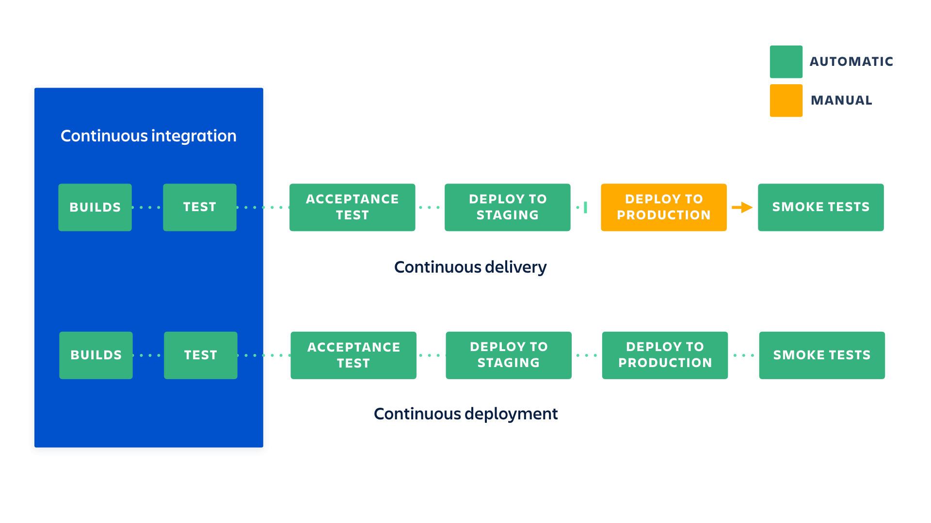
Relationship b/w ci & CD’s

Slide 31
Efforts required
Need to write best quality automated tests for each new feature, improvement or bug fixes covering all the positive and negative scenarios.
Better to incorporate feature flags for any new feature included in the release so that issues can be easily addressed by enabling/disabling the feature.
Need a continuous integration server that can monitor the main repository and run the tests automatically for every new commits pushed.
Developers need to merge their changes as often as possible, at least once a day so that issues can be addressed as soon as possible
Must release “Release notes” for every deployment as it is the key player for your changes.

Slide 32
GAIN with CI/CD
Less bugs get shipped to production as regressions are captured early by the automated tests.
Building the release is easy as all integration issues have been solved early.
Less context switching as developers are alerted as soon as they break the build and can work on fixing it before they move to another task.
Testing costs are reduced drastically – your CI server can run hundreds of tests in the matter of seconds.
QA team spend less time testing and can focus on significant improvements to the quality culture.
The complexity of deploying software has been taken away. Team doesn't have to spend days preparing for a release anymore.
Release can be done more often as less overhead involved with the automation.
Easily can figure out which change is causing the issue as releases are done in batches so easy to back trace.

Slide 33
CI Tools
1) Buddy
2) BuildMaster
3) Jenkins
4) TeamCity
5) GoCD
6) Bamboo
7) Gitlab CI
8) CircleCI
9) Codeship
10) Buildbot
11) Nevercode
12) Integrity
13) Strider
etc

Slide 34
Jenkins
Jenkins is an open-source continuous integration tool. It is written using the Java programming language. It facilitates real-time testing and reporting on isolated changes in a larger code base. This software helps developers to quickly find and solve defects in their code base & automate testing of their builds.
Features:
Provide support to scale out to a large number of nodes and distribute the workload equally among them
Easily updated with all OS and versions of Linux, Mac OS or Windows
It offers easy installation as Jenkins comes as a WAR file all you need to drop into your JEE container and your setup up ready to run.
Jenkins can be easily set up and configured with the help of its web interface
It can easily distribute work across several machines
Link: https://jenkins.io/
Jenkins installation guide: https://linuxize.com/post/how-to-install-jenkins-on-ubuntu-18-04/

Slide 35
Exercise
Create a Jenkins job to build your source code and run the test cases periodically.
Create a Jenkins job to build and test your source code as soon as you commit any changes to your repo.
Add a rule to send mail with the test result status.

Slide 36
Shell Scripting

Slide 37
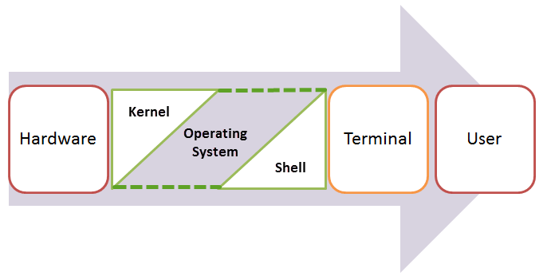

What is a Shell?
An Operating is made of many components, but its two primary components are:
Kernel
Shell
Kernel is the innermost part of an operating system and a shell is the outermost one.
The Shell wraps around the delicate interior of an Operating system protecting it from accidental damage.
Hence the name Shell.
A shell in a Linux operating system takes input from you in the form of commands, processes it, and then gives an output.
It is the interface through which a user works on the programs, commands, and scripts.
A shell is accessed by a terminal which runs it.
Kernel
Shell

Slide 38
Types of Shell
There are two main shells in Linux:
1. The Bourne Shell: The prompt for this shell is $ and its derivatives are listed below:
POSIX shell also is known as sh
Korn Shell also known as sh
Bourne Again SHell also known as bash (most popular)
2. The C shell: The prompt for this shell is %, and its subcategories are:
C shell is also known as csh
Tops C shell also is known as tcsh
What is Shell Scripting?
Shell scripting is writing a series of command for the shell to execute. It can combine lengthy and repetitive sequences of commands into a single and simple script, which can be stored and executed anytime.
This reduces the effort required by the end user.
https://www.guru99.com/introduction-to-shell-scripting.html

Slide 39
Let us understand the steps in creating a Shell Script
Create a file using a vi editor(or any other editor). Name script file with extension .sh
Start the script with #! /bin/sh
Write some code.
Save the script file as filename.sh
For executing the script type bash filename.sh
"#!" is an operator called shebang which directs the script to the interpreter location. So, if we use"#! /bin/sh" the script gets directed to the bourne-shell.
Let's create a small script -
============================================
#!/bin/sh
echo "Hello World\n"
echo "Issuing ls command to see the list of files\n"
ls
============================================
Execute:
bash sample.sh

Slide 40
Exercise
Write a shell script to run your test cases.
Write a shell script to
Capture the 100 photo’s continuously.
Capture the 10 videos (record->pause->record->stop)
Open the gallery and view all the photo’s
Open the gallery and play the videos (play->pause->play->stop)

Slide 41
Android Build Setup

Slide 42
1) Make sure your ubuntu version is 14.04 and JAVA 1.7.x installed in the PC
Command to check version: lsb_release -a
2) Make sure you have available free space : 150-200GB
3) Build instruction for your reference:
https://source.android.com/setup/build/initializing
4) Download "Android Board Support Package vLA.BR.1.2.7-01010-8x16.0-4"
from https://developer.qualcomm.com/hardware/dragonboard-410c/software
(you can register and download it)
5) Unzip above downloaded file and you can see proprietary_LA.BR.1.2.7-01010-8x16.0_410C_May.tgz & DB410c_build.sh files
6) Open terminal and cd to it and run below commands
chmod a+x DB410c_build.sh
./DB410c_build.sh ( TRY TO UNDERSTAND THIS FILE)
7) Step – 6 downloads the Android code, builds it and generates all the required Android images to flash.
Go through : https://developer.qualcomm.com/download/db410c/linux-android-software-build-and-installation-guide.pdf

Slide 43
Thank you …

